Slide 1
Wednesday, October 18, 2017
Write In Your Agenda:
Write In Your Monitoring Log:
CW:
Interactives Dynamic Earth Website Questions (online)
An Inside Look at the San Andreas Fault
HW:
Finish "Interactives Dynamic Earth Website Questions".
Response to Warm-Up:
What did you do over the break?
You will need:
Pencil
Agenda
New Monitoring Log

Slide 2
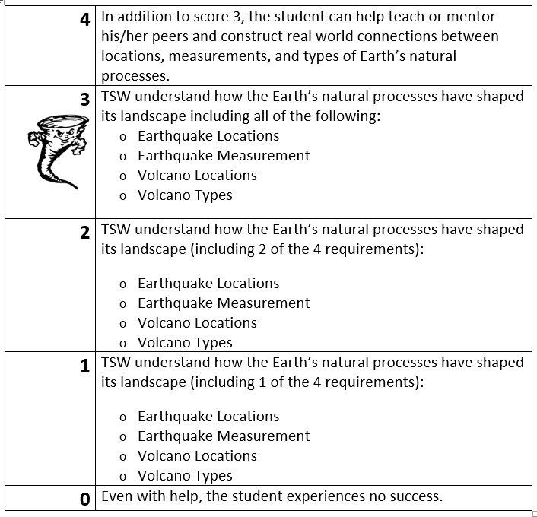
Learning Goal and Scale
TSW understand how the Earth’s natural processes have shaped its landscape (including Earthquake locations and how they are measured as well as Volcano locations and the three types).

